Slide 1
Defend the Vulns
Group Members:
Aawan Adhikari
Prabin Bhandari
Tutor:
Clinton Hayes
Unit Coordinator:
Jamie Shield

Slide 2
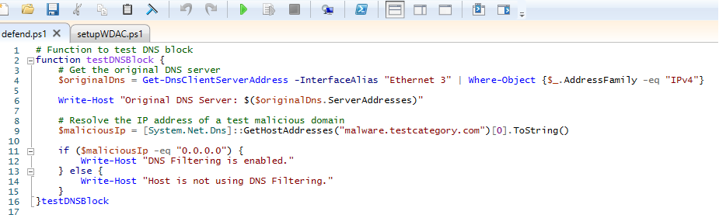
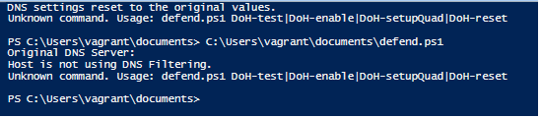
DNS filtering to block malicious domains. (TestDNS)
Before proceeding forward, we need to test the if the filtering function is working properly or not. We can do this by using TestDNSBlock function. By using the function in the code, we can see in the output that it says “Host is not using DNS filtering.” This proves that the IP address of the malicious app is not 0.0.0.0.

Slide 3
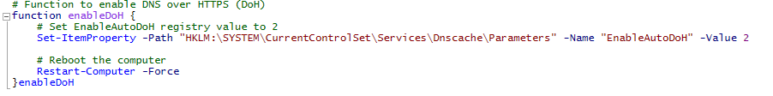
Function Enable DoH
The enableDoH function helps to enable the DNS over HTTPS on the given machine or device. The value 2 is applied on the code to prevent the crashing or fallback of the system.
After running this code, the system reboots itself. We can use this command if the computer or system needs a restart to freshen up.

Slide 4
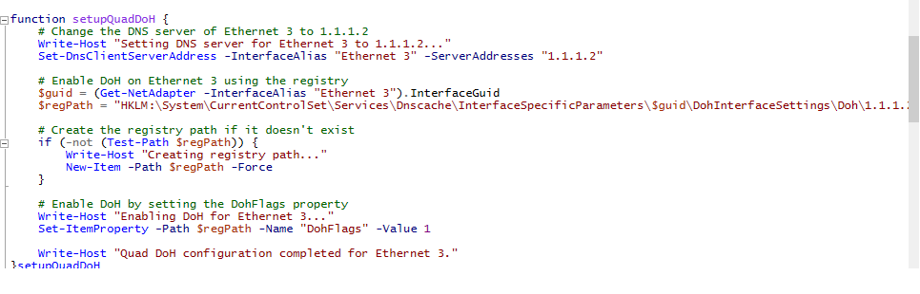
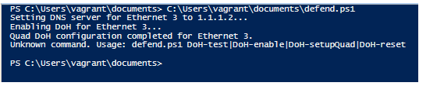
Function Setup Quad DoH
After applying the function Setup Quad DoH, the system changes DNS server of the ethernet to 1.1.1.0. It also registers a DoH template by using the function Add-DnsClientServerAddress. And we can enable the DoH on Ethernet 3 by using a registry.
After running the code, we can see that System is setting DNS server, Enabling DoH and at last, it says, Quad DoH configuration had been completed for Ethernet 3.

Slide 5
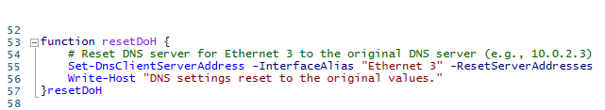

Function ResetDoH
By using this feature, all the settings in the DNS server reverts to its original or default settings. All the values that were changed or assigned in the server gets reset to their original value.

Slide 6
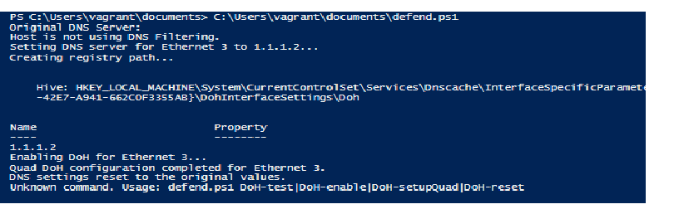
After running all the code together, the result / output comes as:

Slide 7
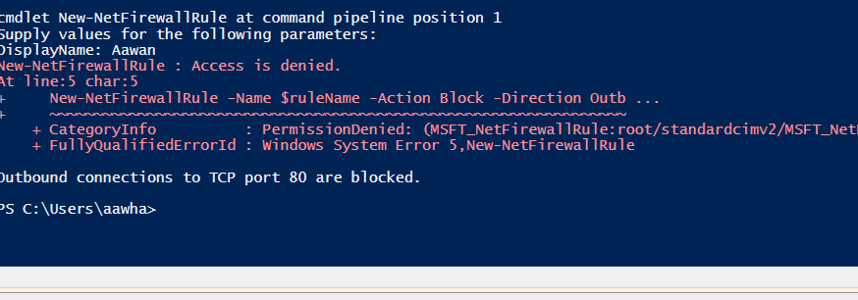
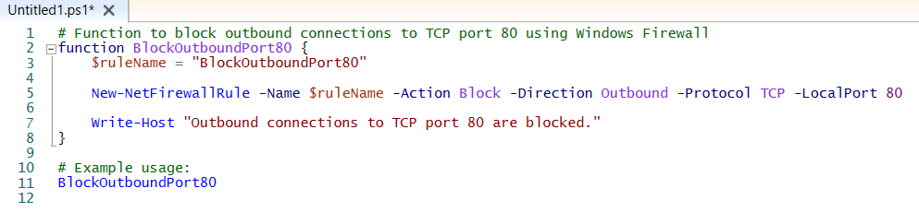
Function BlockHTTP
This feature limits the malicious application’s capability to communicate over HTTP with the system. This results in restriction of the app and prevention of malware in the system. When we run the code, all the outbound connection to the TCP port80 would be blocked. If the user wants to block any other ports, they can simply change the port number in the above code.

